Slide 1


Encryption, RSA
Slides prepared from the book “Cryptography and Network Security principles and Practices” by William Stallings

Slide 2
Welcome!!
Insert the title of your subtitle Here

Slide 3
Learning Outcomes
Understand the concept of Encryption
Differentiate Private and public key algorithm
Understanding of RSA algorithm
Trapdoor functions

Slide 4
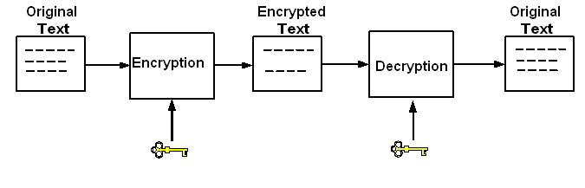
Encryption
Keeping information out of the hands of unauthorized users
• Original text is referred to as “Message”
• Encrypted text is called “Ciphertext”

Slide 5
Encryption Types
Two major types of Encryption
• Symmetric Key Algorithm
• Asymmetric Key Algorithm

Slide 6
Historic Encryption Techniques
The type of operations
  All encryption algorithms are based on two general principles:
  Substitution, in which each element in the plaintext (bit, letter, group of bits or letters) is mapped into another element,
  Transposition, in which elements in the plaintext are rearranged.

Slide 7
The Substitution Cipher
  A substitution cipher is one in which the letters of plaintext are replaced by other letters or by numbers or symbols.
  If the plaintext is viewed as a sequence of bits, then substitution involves replacing plaintext bit patterns with cipher text bit patterns.

Slide 8
The Caesar Cipher
  The earliest known, and the simplest, use of a substitution cipher was by Julius Caesar.
  The Caesar cipher involves replacing each letter of the alphabet with the letter standing few (typically three) places further down the alphabet.

Slide 9
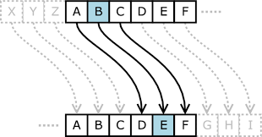
The Caesar Cipher
  For example
  plaintext: meet me after the toga party
  ciphertext: PHHW PH DIWHU WKH WRJD SDUWB
Plaintext | a | b | c | d | e | f | g | h | i | j | k | l | m | N | o | p | q | r | s | t | u | v | w | x | y | z
Ciphertext | D | E | F | G | H | I | J | K | L | M | N | O | P | Q | R | S | T | U | V | W | X | Y | Z | A | B | C

Slide 10
The Caesar Cipher - Problem
  If it is known that a given ciphertext is a Caesar cipher, then a brute-force cryptanalysis is easily performed.
  Simply try all the 25 possible keys.

Slide 11
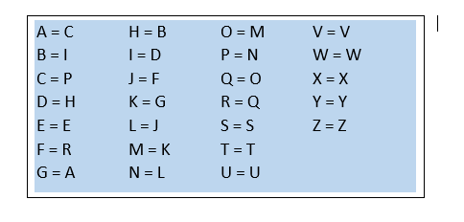
The Mono-alphabetic Cipher
  A dramatic increase in the key space can be achieved by allowing an arbitrary substitution.

Slide 12

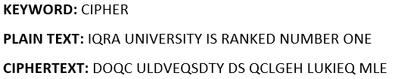
The Mono-alphabetic Cipher (with keyword)
  A dramatic increase in the key space can be achieved by allowing an arbitrary substitution.

Slide 13
The Mono-alphabetic Cipher - Problem
  If the cryptanalyst knows the nature of the plaintext (e.g., non-compressed English text), then the analyst can exploit the regularities of the language.
  Every language has certain frequency distribution of its letters, so as English language.
  The frequency distribution of English language is as follows:

Slide 14
The Mono-alphabetic Cipher - Problem

Slide 15
The Mono-alphabetic Cipher - Problem
  To see how such a cryptanalysis might proceed, we give a partial example here. The ciphertext to be solved is
UZQSOVUOHXMOPVGPOZPEVSGZWSZOPFPESXUDBMETSXAIZVUEPHZHMDZSHZOWSFPAPPDTSVPQUZWYMXUZUHSXEPYEPOPDZSZUFPOMBZWPFUPZHMDJUDTMOHMQ

Slide 16
The Mono-alphabetic Cipher - Problem

Slide 17
The Mono-alphabetic Cipher - Problem
  As a first step, the relative frequency of the letters can be determined and compared to a standard frequency distribution for English
  If the message were long enough, this technique alone might be sufficient, but because this is a relatively short message, we cannot expect an exact match.

Slide 18
The Mono-alphabetic Cipher - Problem
  Comparing this breakdown with frequency distribution of English, it seems likely that cipher letters P and Z are the equivalents of plain letters e and t, but it is not certain which is which.
  The letters S,U,O,M, and H are all of relatively high frequency and probably correspond to plain letters from the set {a, h, i, n, o, r, s}.
  The letters with the lowest frequencies (namely, A,B,G,Y, I, J) are likely included in the set {b, j, k, q, v, x, z}

Slide 19
The Mono-alphabetic Cipher - Problem
UZQSOVUOHXMOPVGPOZPEVSGZWSZOPFPESXUDBMETSXAIZ
t a e e te a t h a t e e a a
VUEPHZHMDZSHZOWSFPAPPDTSVPQUZWYMXUZUHSX
e t t a t h a e ee a e t h t a
EPYEPOPDZSZUFPOMBZWPFUPZHMDJUDTMOHMQ
e e e t a t e t h e t
it was disclosed yesterday that several informal but
direct contacts have been made with political
representatives of the vietcong in moscow

Slide 20
The Playfair Cipher
  The Playfair cipher was the first practical digraph (pair of alphabets) substitution cipher.
  If
  The scheme was invented in 1854 by Charles Wheatstone but was named after Lord Playfair who promoted the use of the cipher.

Slide 21
The Playfair Cipher
  The Playfair algorithm is based on the use of a 5×5 matrix of letters constructed using a keyword.
  If the keyword is monarchy. The matrix is constructed by filling in the letters of the keyword (minus duplicates) from left to right and from top to bottom, and then filling in the remainder of the matrix with the remaining letters in alphabetic order.
  The letters I and J count as one letter (Normally J is omitted).

Slide 22
The Playfair Cipher
M | O | N | A | R
C | H | Y | B | D
E | F | G | I/J | K
L | P | Q | S | T
U | V | W | X | Z

Slide 23
The Playfair Cipher
  Plaintext is encrypted two letters at a time, according to the following rules:
    Repeating plaintext letters that are in the same pair are separated with a filler letter, such as x, so that balloon would be treated as ba lx lo on.
    x (sometime z) is also used to fill second letter in the diagram if there is an odd number of letter.
    Two plaintext letters that fall in the same row of the matrix are each replaced by the letter to the right, with the first element of the row circularly following the last. For example, AR is encrypted as RM.

Slide 24
The Playfair Cipher
  Plaintext is encrypted two letters at a time, according to the following rules:
    Two plaintext letters that fall in the same column are each replaced by the letter beneath, with the top element of the column circularly following the last. For example, MU is encrypted as CM.
    Otherwise, each plaintext letter in a pair is replaced by the letter that lies in its own row and the column occupied by the other plaintext letter. Thus, HS becomes BP and EA becomes IM (or JM, as the encipherer wishes).

Slide 25
The Playfair Cipher
  If keyword is Monarchy and
  plaintext is Instruments
  Then first break the plaintext is converted into cipher text as follows:
M | O | N | A | R
C | H | Y | B | D
E | F | G | I/J | K
L | P | Q | S | T
U | V | W | X | Z
Plaintext | in | st | ru | me | nt | sx
Ciphertext | GA | TL | MZ | CL | RQ | XA

Slide 26
The Transposition Cipher
  A very different kind of mapping is achieved by performing some sort of permutation on the plaintext letters. This technique is referred to as a transposition cipher.

Slide 27
The Scytale Cipher
  The Scytale Cipher was used in ancient Greek times to encrypt messages.
  The device used to make these ciphers was a rod with a polygon base, which was wrapped in paper.

Slide 28
The Scytale Cipher
  People could write on the paper horizontally.
  When the paper was removed from the device, it would make a strip of letters that seemed randomized.
  The only way to read the message would be to have a Scytale machine of one's own.

Slide 29
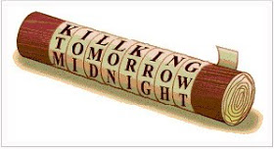

The Scytale Cipher

Slide 30
The Rail Fence Cipher
  The simplest such cipher is the Rail Fence technique, in which the plaintext is written down as a sequence of diagonals and then read off as a sequence of rows.
  For example, to encipher the message “meet me after the party” with a rail fence of depth 2, we write the following:

Slide 31
The Rail Fence Cipher
Plaintext |  | meet me after the party
Rail Fence with Depth 2 |  | m |  | e |  | m |  | a |  | t |  | r |  | h |  | p |  | r |  | y
 |  |  | e |  | t |  | e |  | f |  | e |  | t |  | e |  | a |  | t
Ciphertext |  | M | E | M | A | T | R | H | P | R | Y | E | T | E | F | E | T | E | A | T

Slide 32
Plaintext |  | ?
Rail Fence with Depth 2
Ciphertext |  | I | R | R | N | E | N | M | E | O | E | Q | A | A | K | D | U | B | R | N

Slide 33
The Rail Fence Cipher
Plaintext |  | this is a secret message
Rail Fence with Depth 4 |  | t |  |  |  |  |  | a |  |  |  |  |  | t |  |  |  |  |  | g
 |  |  | h |  |  |  | s |  | s |  |  |  | e |  | m |  |  |  | a |  | e
 |  |  |  | i |  | i |  |  |  | e |  | r |  |  |  | e |  | s
 |  |  |  |  | s |  |  |  |  |  | c |  |  |  |  |  | s
Ciphertext |  | T | A | T | G | H | S | S | E | M | A | E | I | I | E | R | E | S | S | C | S

Slide 34
The Rail Fence Cipher (Practice Question)
Plaintext |  | ?
Rail Fence with Depth 4
Ciphertext |  | B | I | T | W | E | N | V | I | Y | O | N | S | U | E | S | I | T | T | R | N

Slide 35
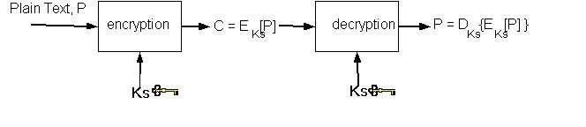
Symmetric Key or Secret Key
Cryptography
• encryption and decryption use the same key
• If this secret/single key is disclosed, Communications are compromised
• Data Encryptions Standard (DES) - 1977
• Advanced Encryption Standard (AES) – 2001

Slide 36
Secret Key Cryptography Drawbacks
•If the key is disclosed, communication is compromised
•Keys must be exchanged before transmission with any recipient or potential recipient of your message. So, to exchange keys you need a secure method of transmission, this means that you must either use a secure channel or meet in person in order to share
this key. This can be a large problem, and is certainly less than
convenient
•Also does not protect sender from receiver forging a message
and claiming is sent by sender, parties are equal

Slide 37
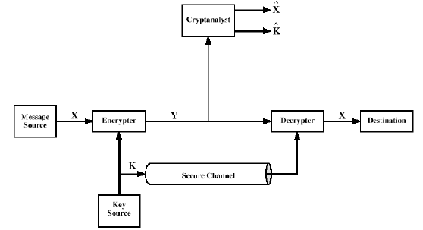

Slide 38
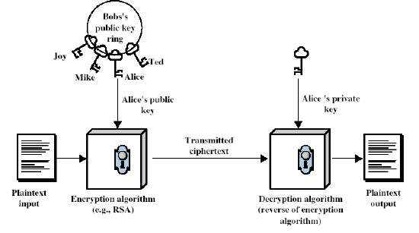
Asymmetric Key or Public Key Cryptography
• Consists of a private key and a public key pair
• Public key can be known by the public

Slide 39
Developed to address two key issues:
Key distribution – how to have secure communications in general without having to trust a KDC with your key
digital signatures – how to verify a message comes
intact from the claimed sender

Slide 40
Public Key Cryptography [More]
Can be used in three ways
•Encryption/decryption
•Digital Signature
•Key Exchange
Like private key schemes brute force exhaustive search attack is always theoretically possible
But keys used are too large (>512bits)
Requires the use of very large numbers
Hence is slow compared to private key schemes

Slide 41
Alice, Bob and Trudy
• In a Public Key system when Alice sends email to Bob, she finds his public key (possibly in a directory of some sort) and encrypts
her message using that key.
• Unlike secret-key cryptography, though, the key used to encrypt
will not decrypt the ciphertext. Knowledge of Bob’s public key will
not help an eavesdropper.
• To decrypt, Bob uses his private key.
• If Bob wants to respond to Alice, he will encrypt his message
using her public key.

Slide 42
Public Key Encryption Has Foundations in Mathematics
• Public key crypto-systems were developed from some very
subtle insights about the mathematics of large numbers and
how they relate to the power of computers
• Public Key Encryption works because of what is known in math as a trapdoor problem
• A trapdoor is a mathematical formula that is easy to work forward but very hard to work backward

Slide 43
Trapdoors are also called One-Way Functions
•The challenge of public-key cryptography is developing a system in which it is impossible (or at least intractable) to deduce the private key from the public key
•This can be accomplished by utilizing a one-way function. With a one-way function, given some input values, it is relatively
simple to compute a result. But if you start with the result, it is
extremely difficult to compute the original input values
•In mathematical terms, given x, computing f(x) is easy, but given f(x), it is extremely difficult to determine x

Slide 44
RSA Algorithm
•Select two large prime numbers, p and q
•Find n=p*q
•Find φ(n)=(p-1)(q-1)
•Select an odd number ‘e’ such that e and φ(n) are relative prime
•Find a number d, such that
de mod φ(n) = 1
Public key = (e, n)
Private key = (d, n)
Verification:
To encrypt a plain text message “M”
C = Me mod n
To decrypt the block
M=C^{d} mod n

Slide 45
RSA Example
p = 3 and q = 11
n = p * q = 3 * 11 = 33
φ(n) = (p - 1) * (q - 1) = 2 * 10 = 20
φ(n) = 20
Choose e such that e and φ(n) are co-prime
Let e = 7
Choose d such that
de mod φ(n) = 1
d = 3
(3)(7)mod20 = 1
Public key is (e, n) => (7, 33)
Private key is (d, n) => (3, 33)
Verification:
The encryption of m = 2 is c = 2⁷ mod 33 = 29
The decryption of c = 29 is m = 29³ mod 33 = 2

Slide 46
Review Questions
What is RSA algorithm and how it helps encrypting the data
What are trapdoor functions
Differentiate symmetric and Asymmetric key encryption

Slide 47
Thank you
Insert the title of your subtitle Here

